Slide 1

Daniel Segan
dsegan@me.com |  @dsegan |  danielsegan

Slide 2
About me
Director of App Innovation @ CloudScale
20+ years in the MS Partner Space
Started way back in the day… before .Net
ASP.Old, C++/MFC/COM, C
Got started on Unix, SunOS/Solaris
A lot of work with Legacy SharePoint
Worked w/ all SP Dev Models over the years
MS Partner based in NYC & LA/SoCal

Slide 3
Overview
Brief rundown of SPFx
Identity in SPFx vs. previous dev models
WSP, Add-Ins
Using AAD Authenticated APIs w/ SPFx
Why do you need it?
Overview of how it works
Unraveling the mystery of getting it working
Demos
Resources
Q&A

Slide 4
Questions
Who’s actively using SPFx?
O365 or On-Premises SharePoint? Mixture?
Are you using SharePoint Modern?
Current web dev frameworks (React, Angular, Vue)?
AppDev: Cloud or On-Premises?
How are you using SharePoint (Web? Mobile? Teams?)

Slide 5
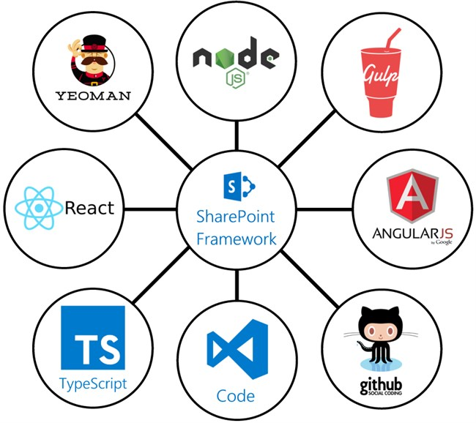
What is SPFx?
Client Side Page & Web Part dev model
Opinionated framework & toolchain
Uses modern “hipster” web dev tools
NPM
Yeoman
Gulp
TypeScript, React, etc.
Lightweight dev/debug process
doesn’t even need SharePoint
Announced at May the 4th SharePoint event 2016
Along with SP Modern Pages etc.

Slide 6
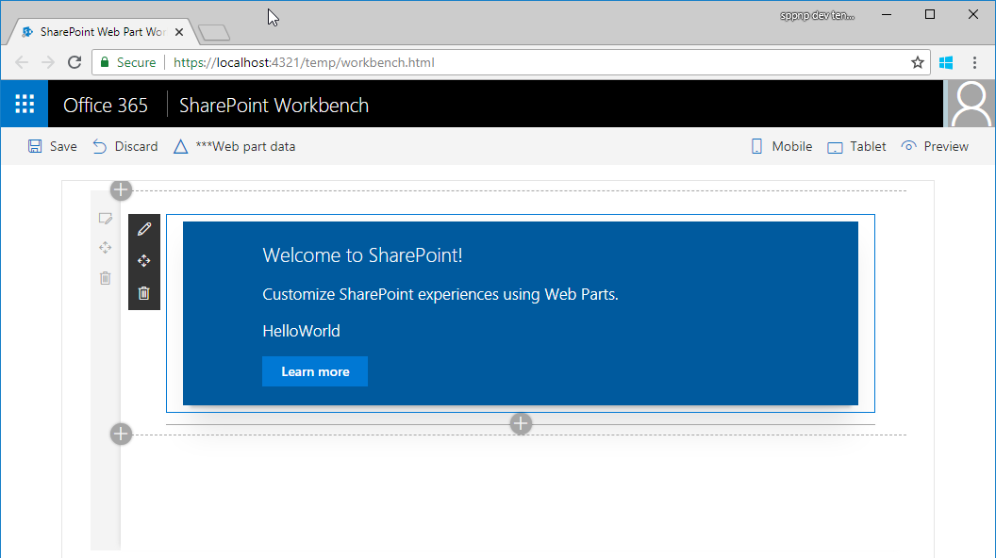
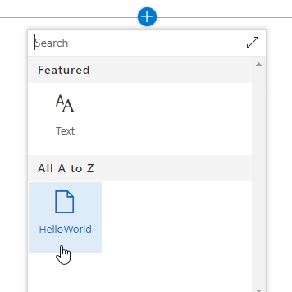
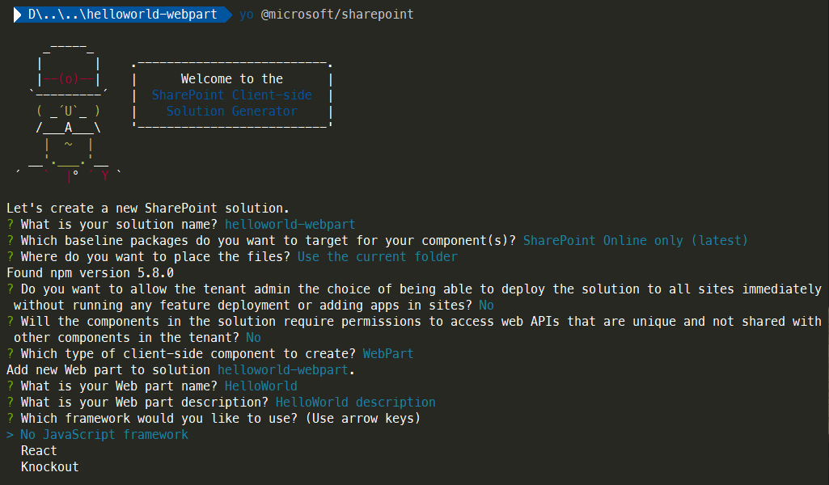
Modern web dev experience
No SharePoint Dev VM
No Visual Studio… unless you want it
No App Registration or Sideloading
You can develop on a Mac or Linux machine
You don’t even need SharePoint, at least to get going

Slide 7
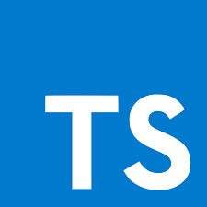
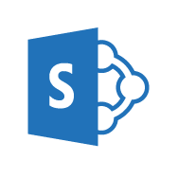

Opinionated, yet flexible

Slide 8
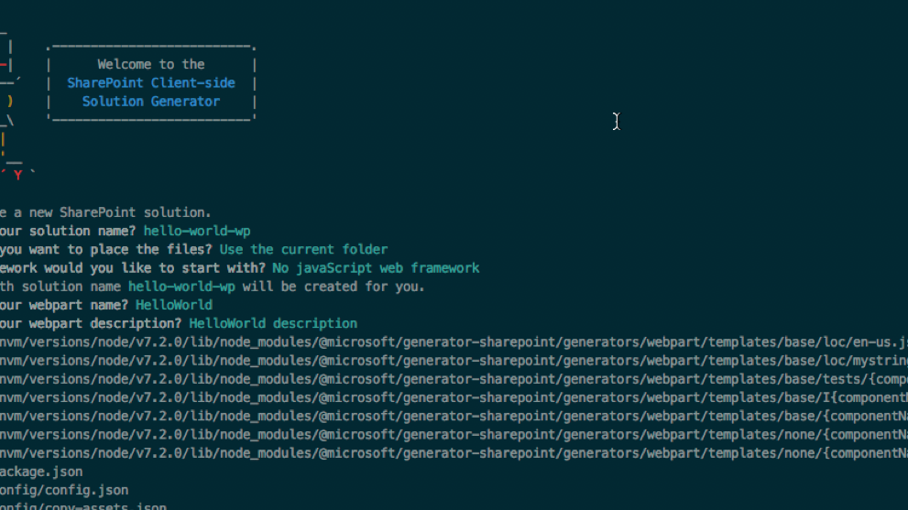
What can you build?
Web Parts
controls that appear inside a SharePoint page but run locally in the browser.
Extensions
Application Customizers
Field Customizers
Command Sets

Slide 9
SPFx Release History
1.8 Release notes - 15th of March 2019*
1.7 Release notes - 8th of November 2018
1.6 Release notes - 5th of September 2018
1.5.1 Release notes - 25th of June 2018
1.5 Release notes - 5th of June 2018
1.4.1 Release notes - 15th of February 2018
1.4 Release notes - 7th of December 2017
1.0 (GA) Release notes - 23rd of February 2017

Slide 10
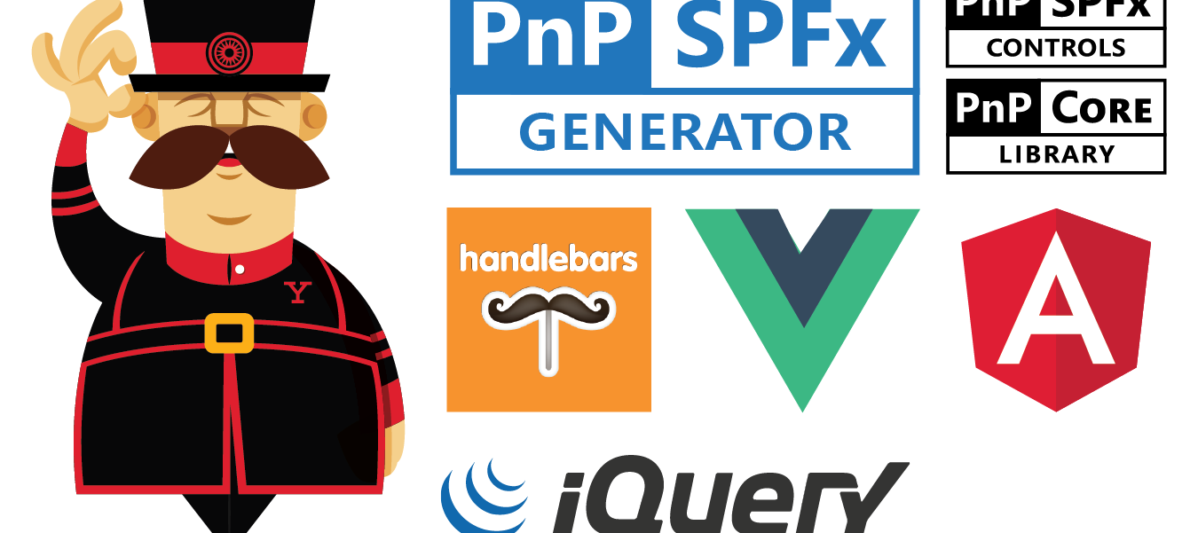
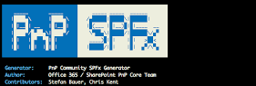
Related projects
Office Fabric / react-fabric
React-based components designed to make it simple for you to create consistent web experiences using the Office Design Language.
PnP
Libraries, components and tools to help with modern SharePoint Development

Slide 11
SPFx vs Other Models…
Client Side Only
Custom solutions run exclusively in the client browser in the context of the current user
Features not implemented yet
All-New Framework
Due to it’s client side nature, some things might never come directly to SPFx
All-New features!
SPFx has features that simply do not exist in other frameworks
Comprehensive Comparison

Slide 12
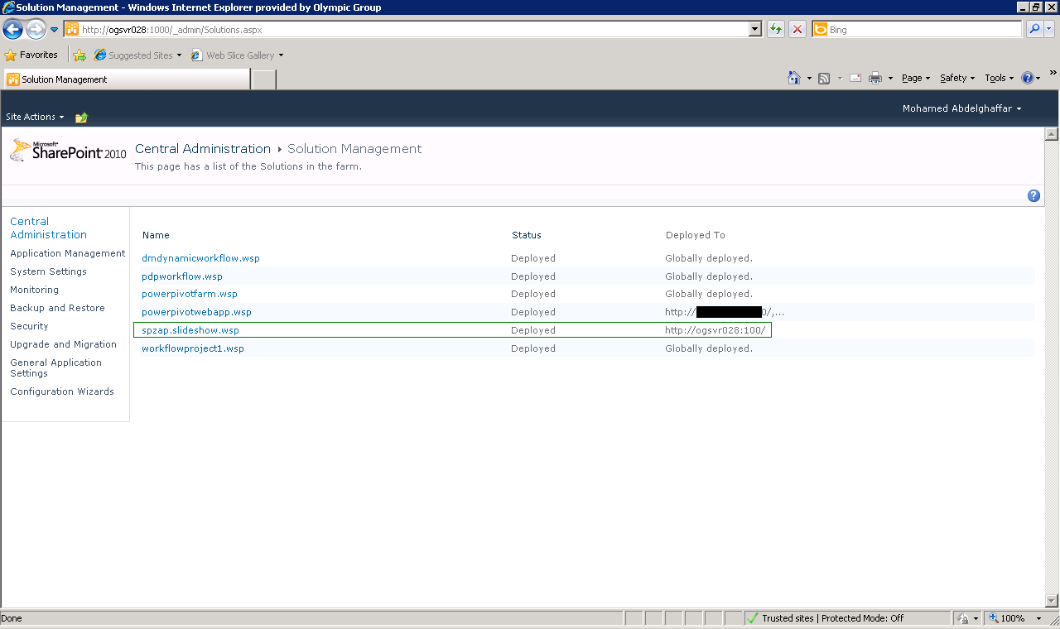
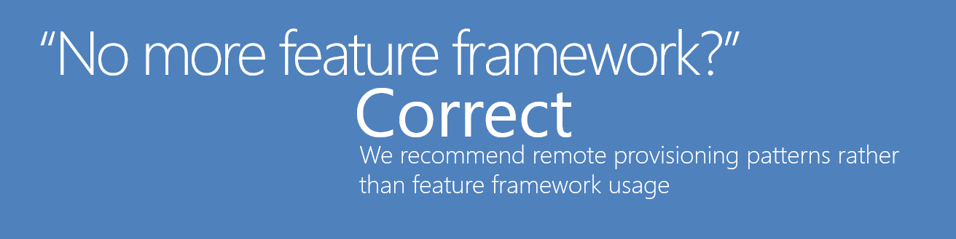
SPFx vs Full-Trust / WSP Solutions…
Arrived w/ SP 2007
WSP Solutions don’t work on SP Online
In-Process dev model, requires invasive deployment
Easy to do things in other security context (RunWithElevatedPrivileges)
Very difficult to use modern web tooling
Feature framework is ancient history

Slide 13

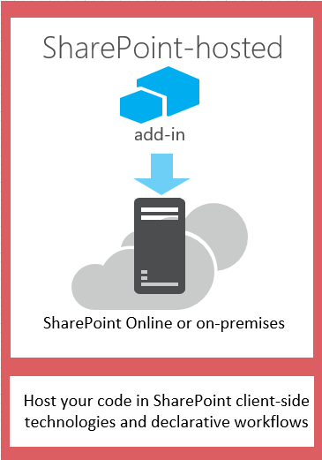

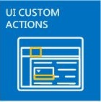
SPFx vs Add-In Solutions…
Arrived w/ SP 2013
Web Parts run in iframe
User & App context
One of the three original models remains viable:
SharePoint Hosted (not recommended)
Autohosted
Provider Hosted

Slide 14
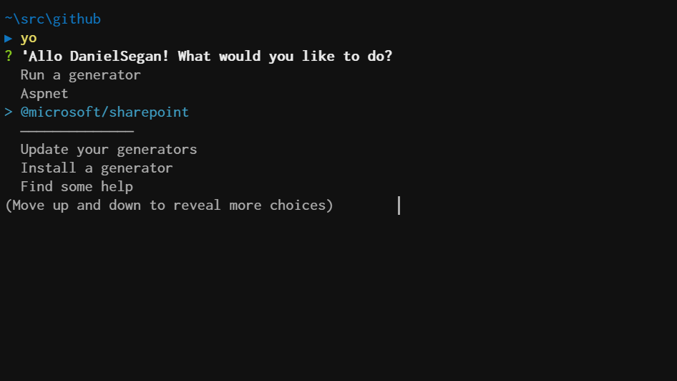
Getting started with SPFx
Install NodeJS
NodeJS (LTS version 8)
Install an editor (VSCode, Sublime, VIM)
Install Yeoman and gulp
Install Yeoman SharePoint generator

Slide 15
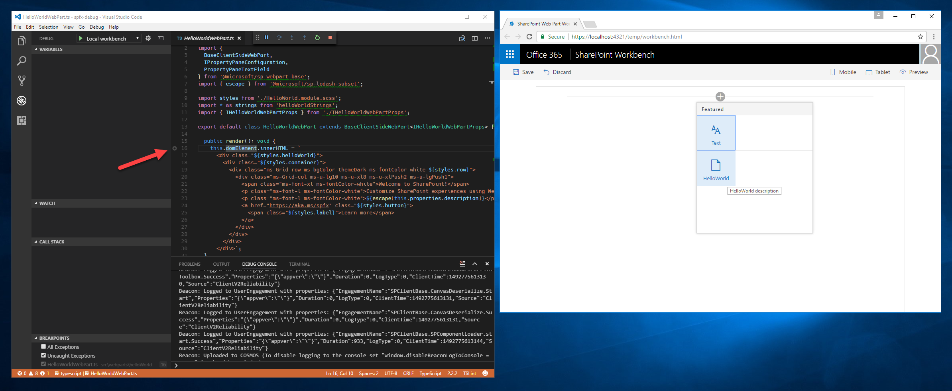
Dev & Debugging

Slide 16
Getting Data
http get
JSON
Rest API
/api/items

Slide 17
Secure API Use Case
API Must be Secured
preferably using some kind of SSO credentials
API should be able to determine who the user is from server side
Credentials shouldn’t be exposed in JavaScript
E.g. API key, etc.
User shouldn’t need to login again
Identity, Authentication and Authorization should be seemless

Slide 18
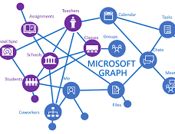
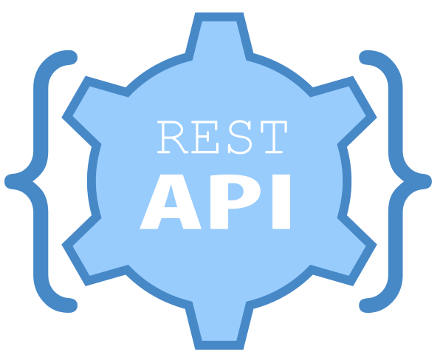
Getting Data
HttpClient
Get data from anywhere
spHttpClient
Get data from SharePoint
MSGraphClient (want to be on v1.6.0 +)
Get data from MS Graph
AadHttpClient (want to be on v1.6.0 + )
Get data from AAD Secured APIs
Other options…
Axios, SuperAgent, Got, etc

Slide 19
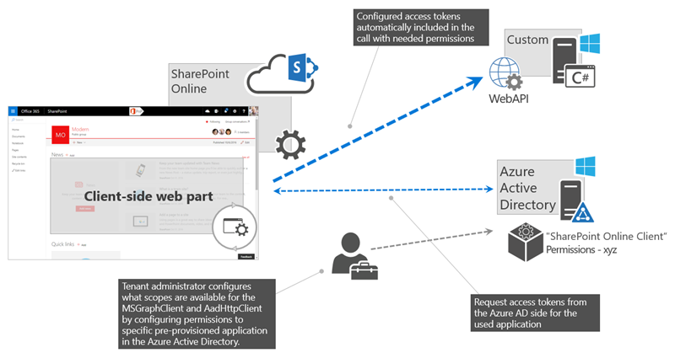

Slide 20


How to consume AAD Authenticated APIs w/ SPFx
AAD Configuration
Setting up the SPFx component
Permission Request Configuring Azure AD
Securing the API on Azure
Easy Way
Securing the API anywhere
Slightly less easy way

Slide 21
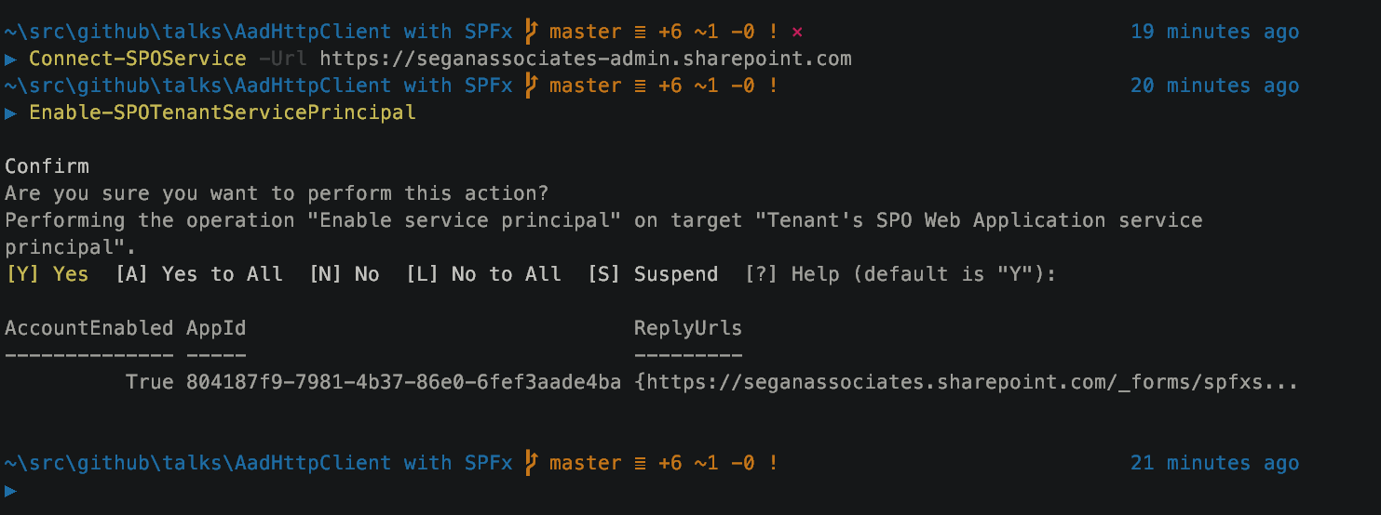
Enable Service Principal

Slide 22
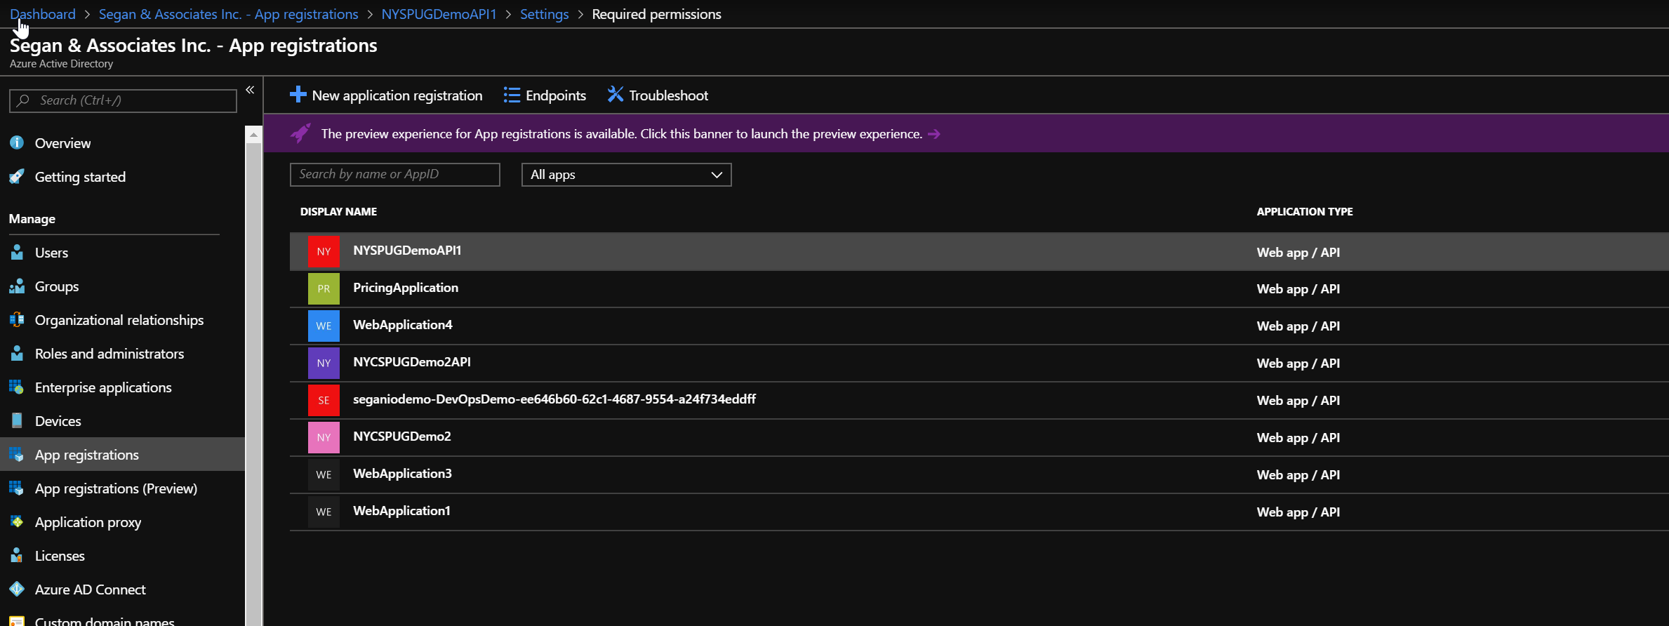
AAD App Registration

Slide 23
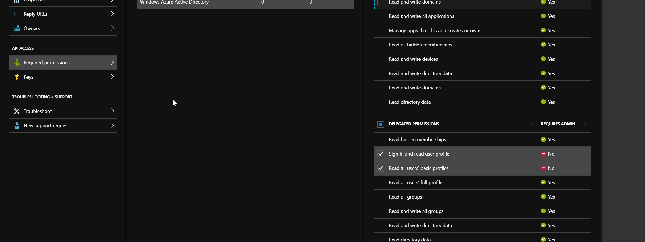
App Reg: Set permissions

Slide 24
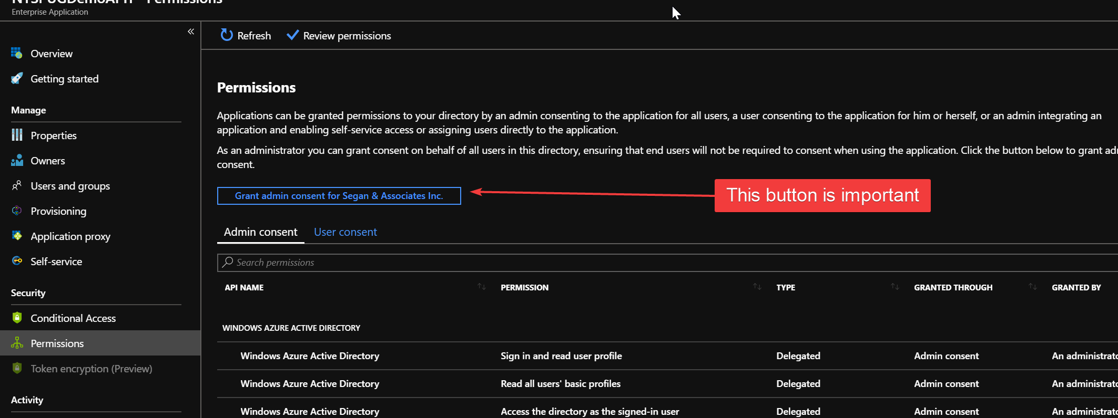
App Reg: Grant Consent

Slide 25
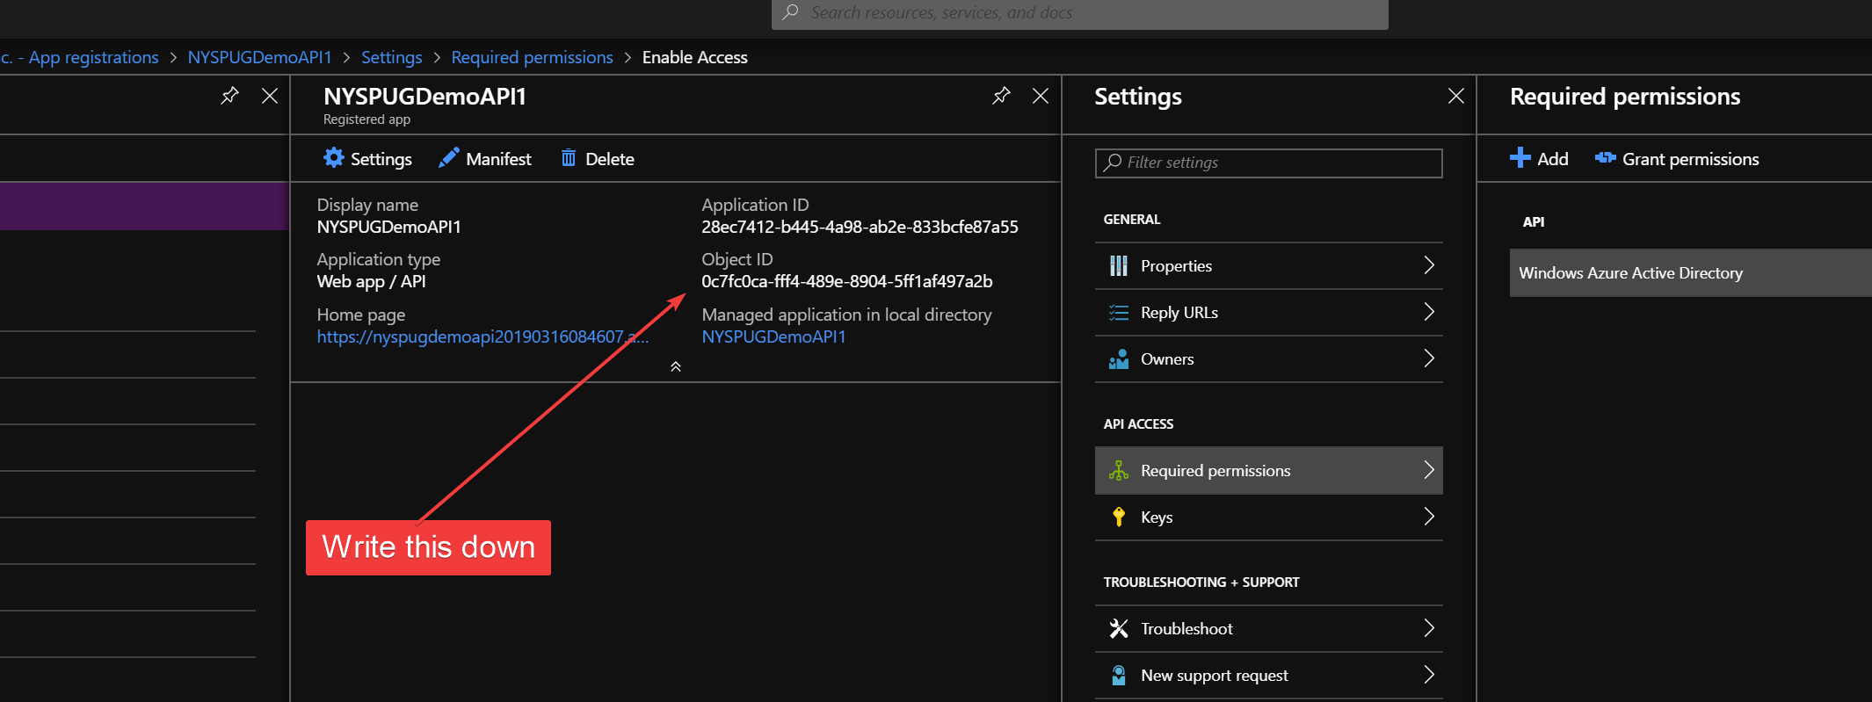
App Reg: Client ID / Object ID

Slide 26
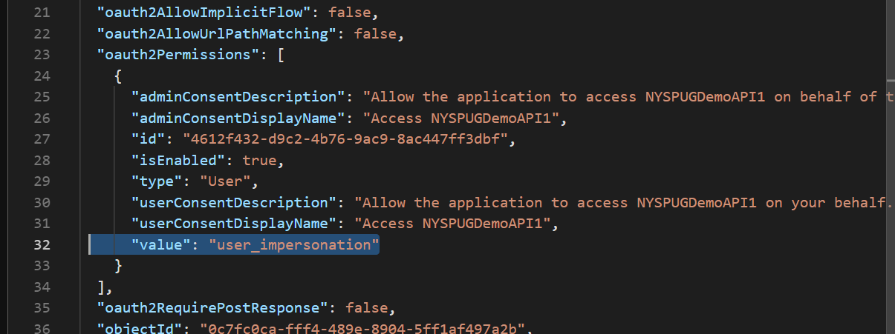
App Reg: Manifest

Slide 27
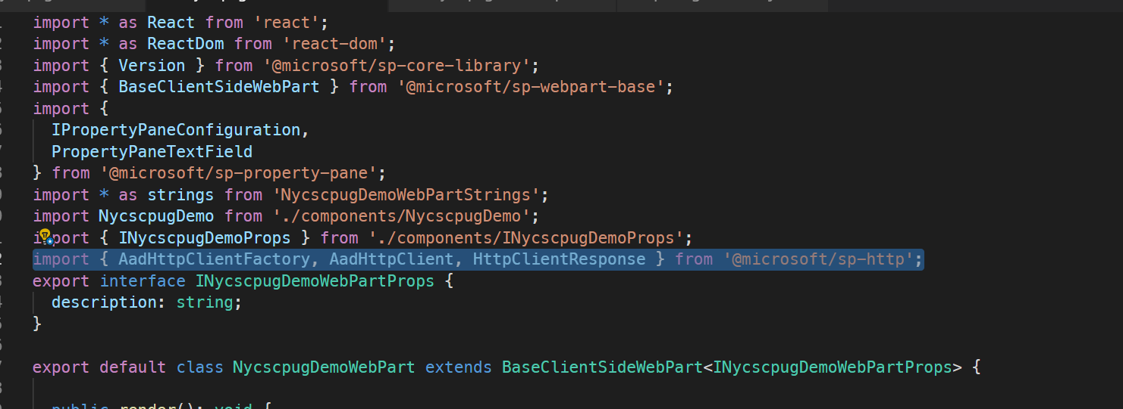
SPFx: Import the AadHttpClient

Slide 28
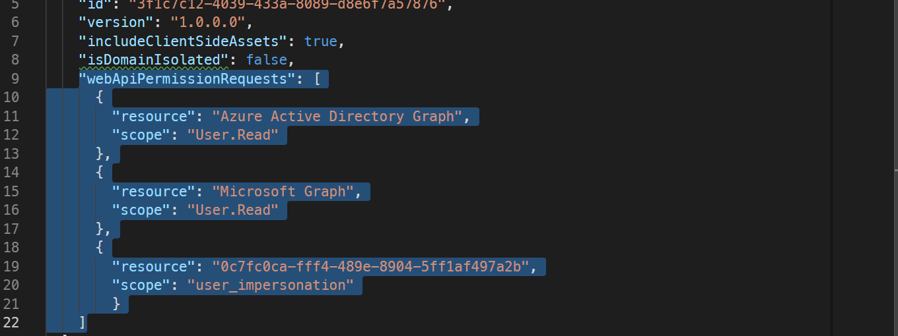
SPFx: Ask for permission

Slide 29
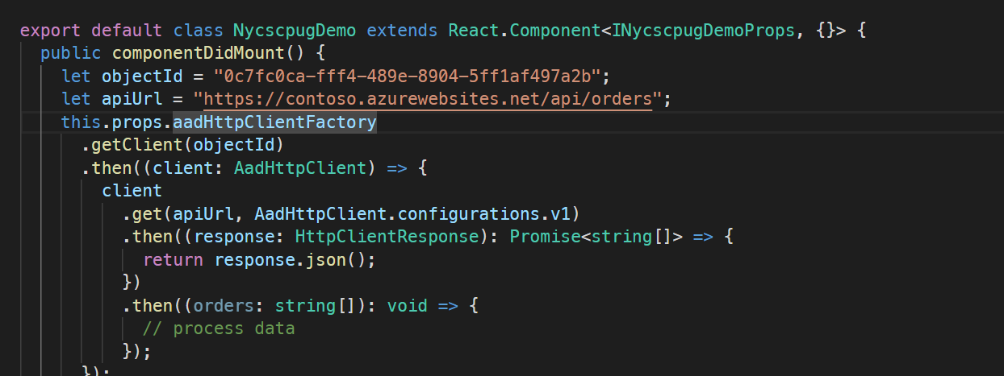
SPFx: Make the call

Slide 30
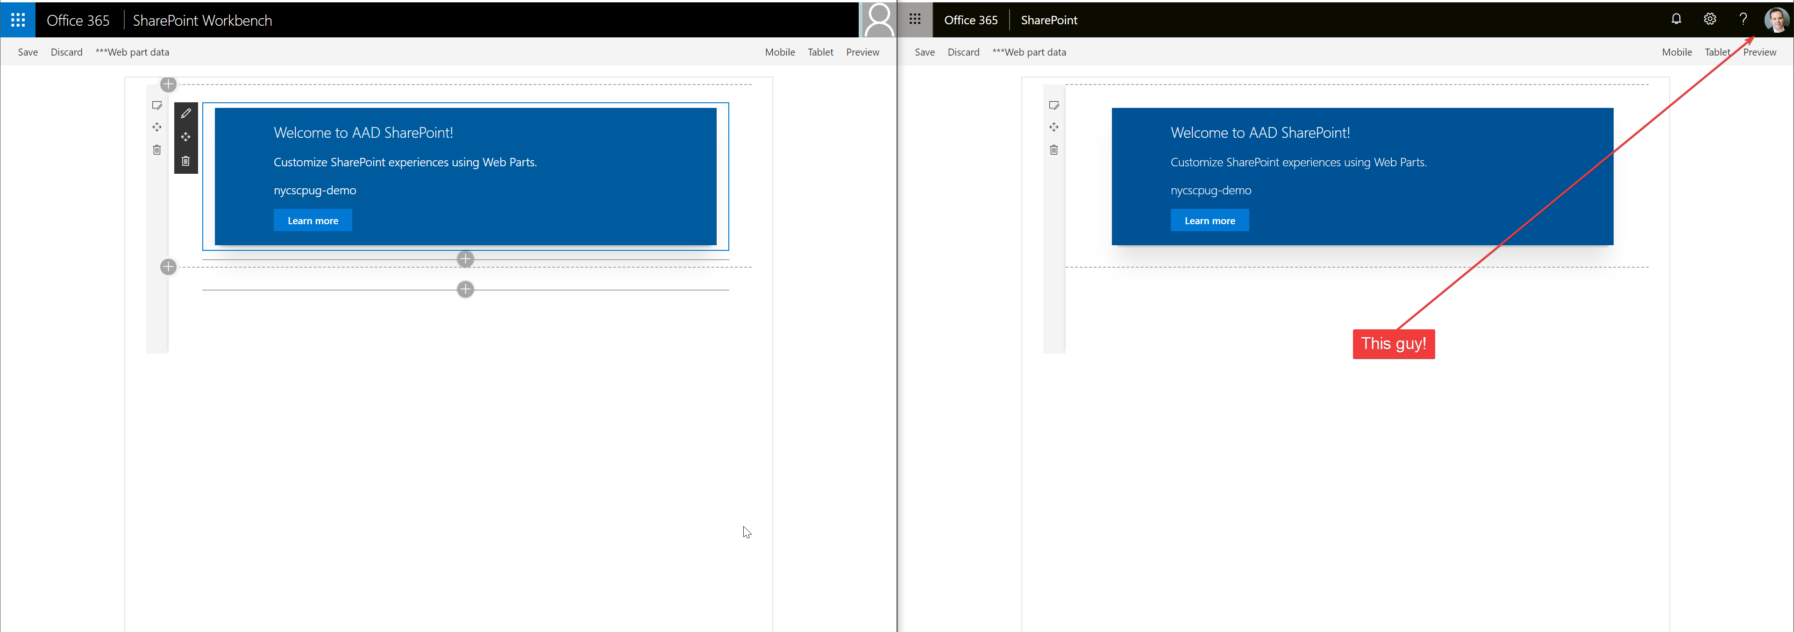
SPFx Workbench
LOCAL
https://localhost:4321/temp/workbench.html
TENNENT
https://*.sharepoint.com/sites/devds/_layouts/15/workbench.aspx

Slide 31
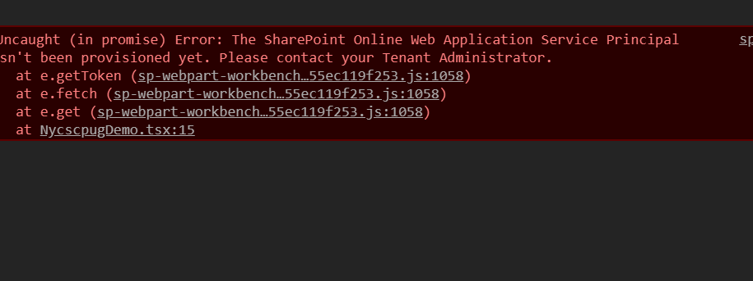
ERROR!

Slide 32
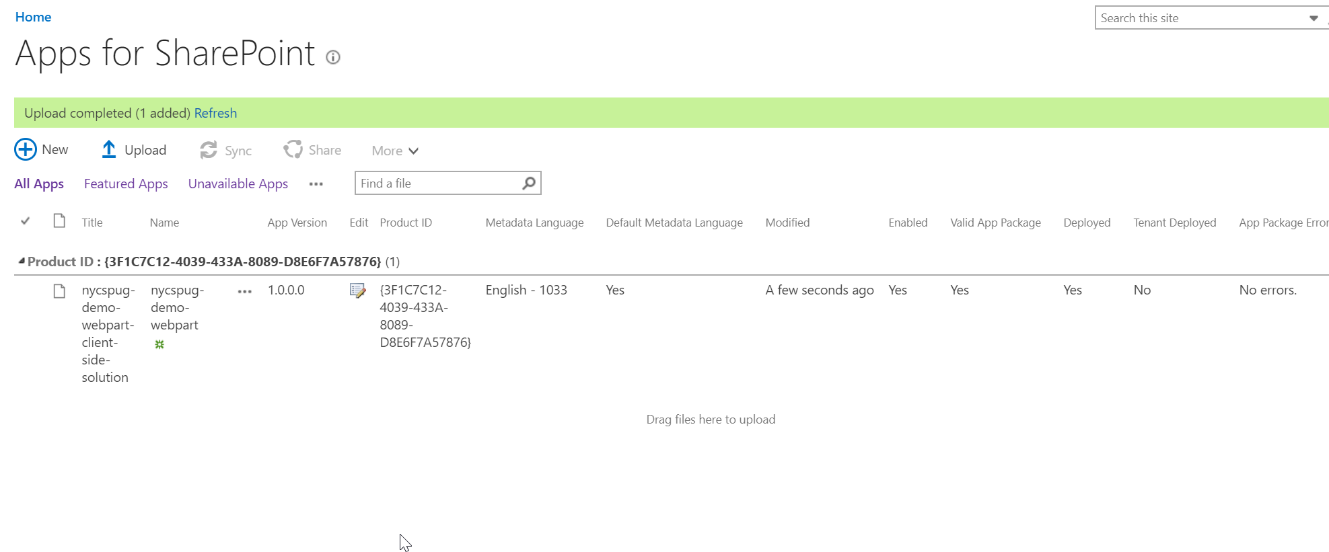
SP Admin: Deploy

Slide 33
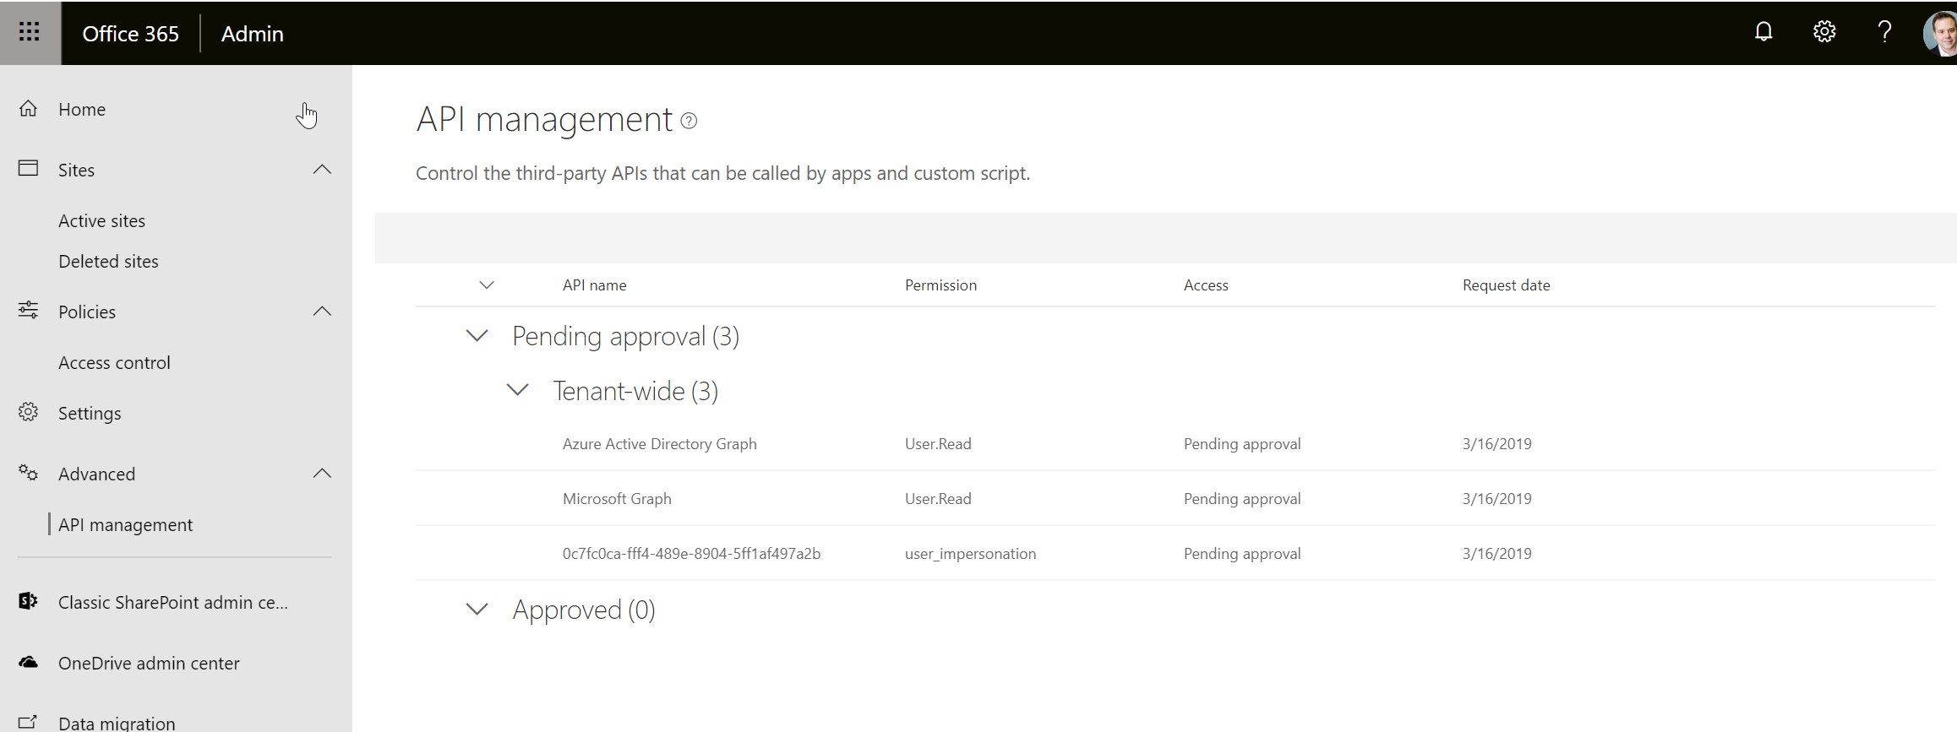
SP Admin: API Managment

Slide 34

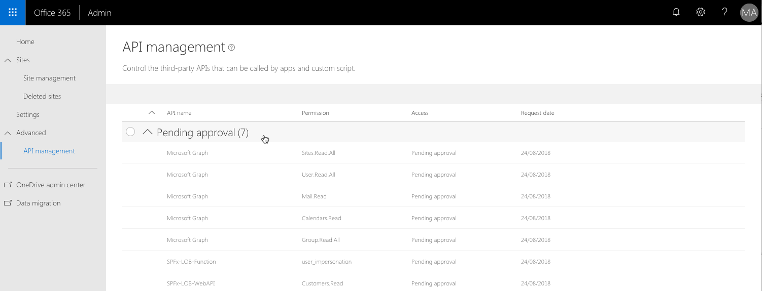
Demo 1: Set up AAD & SPFx
O365 Admin Portal
Accept Permissons

Slide 35
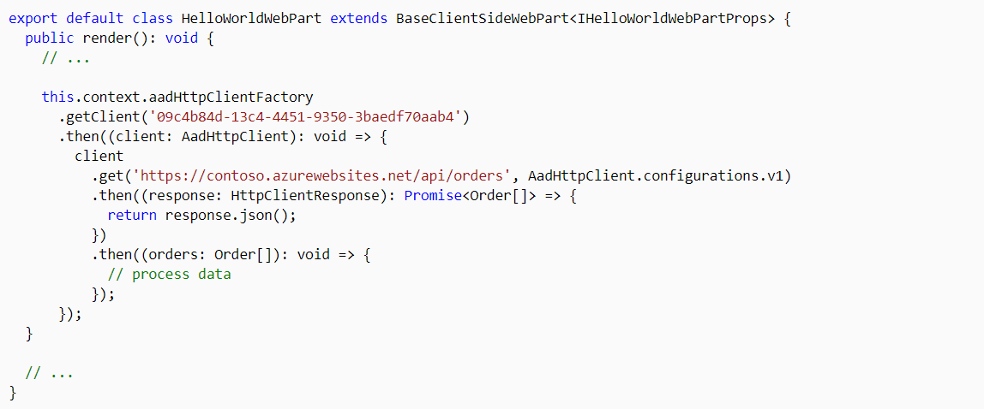
Demo 2: Setup the SPFx component
Use aadHttpClient
Request permissions to an Azure AD application
config/package-solution.json
Manage Permission Requests

Slide 36
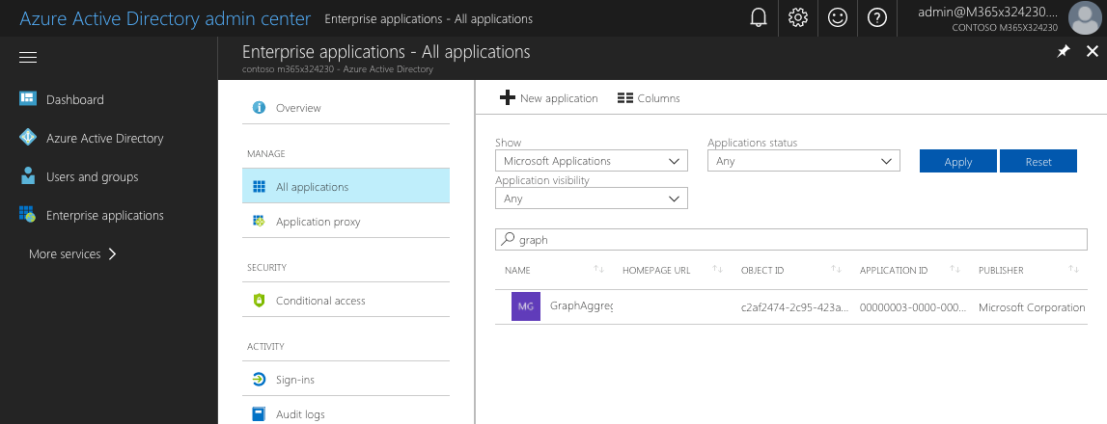
Demo 2: API (Easy Way)
Enable Azure AD Auth
Deploy to Azure

Slide 37
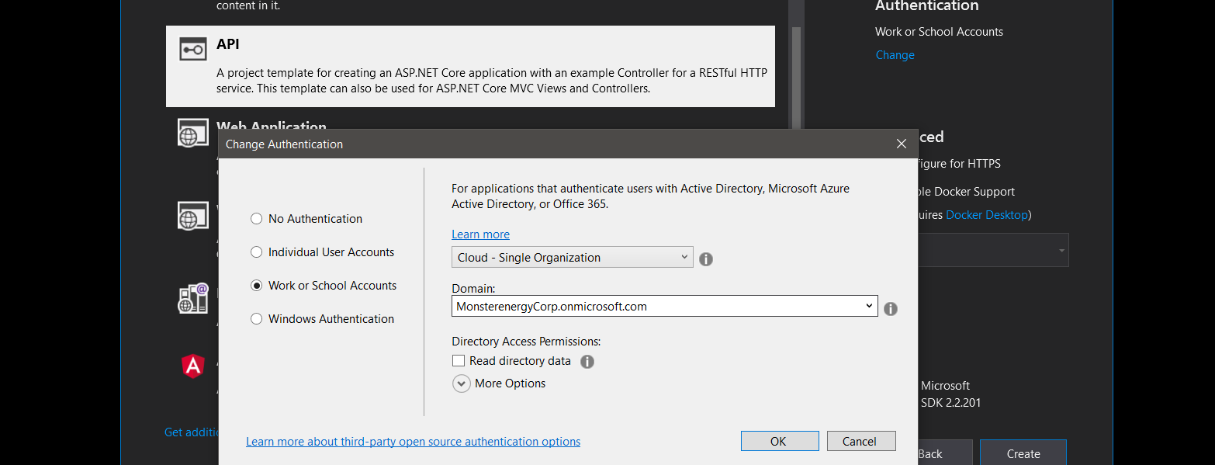
Demo 3: API (Slightly less easy way)
Configure tenant settings
Deploy anywhere

Slide 38
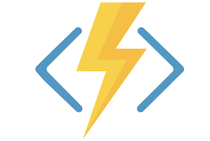

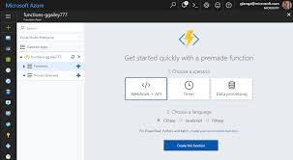
Bonus Topic: Azure Functions

Slide 39
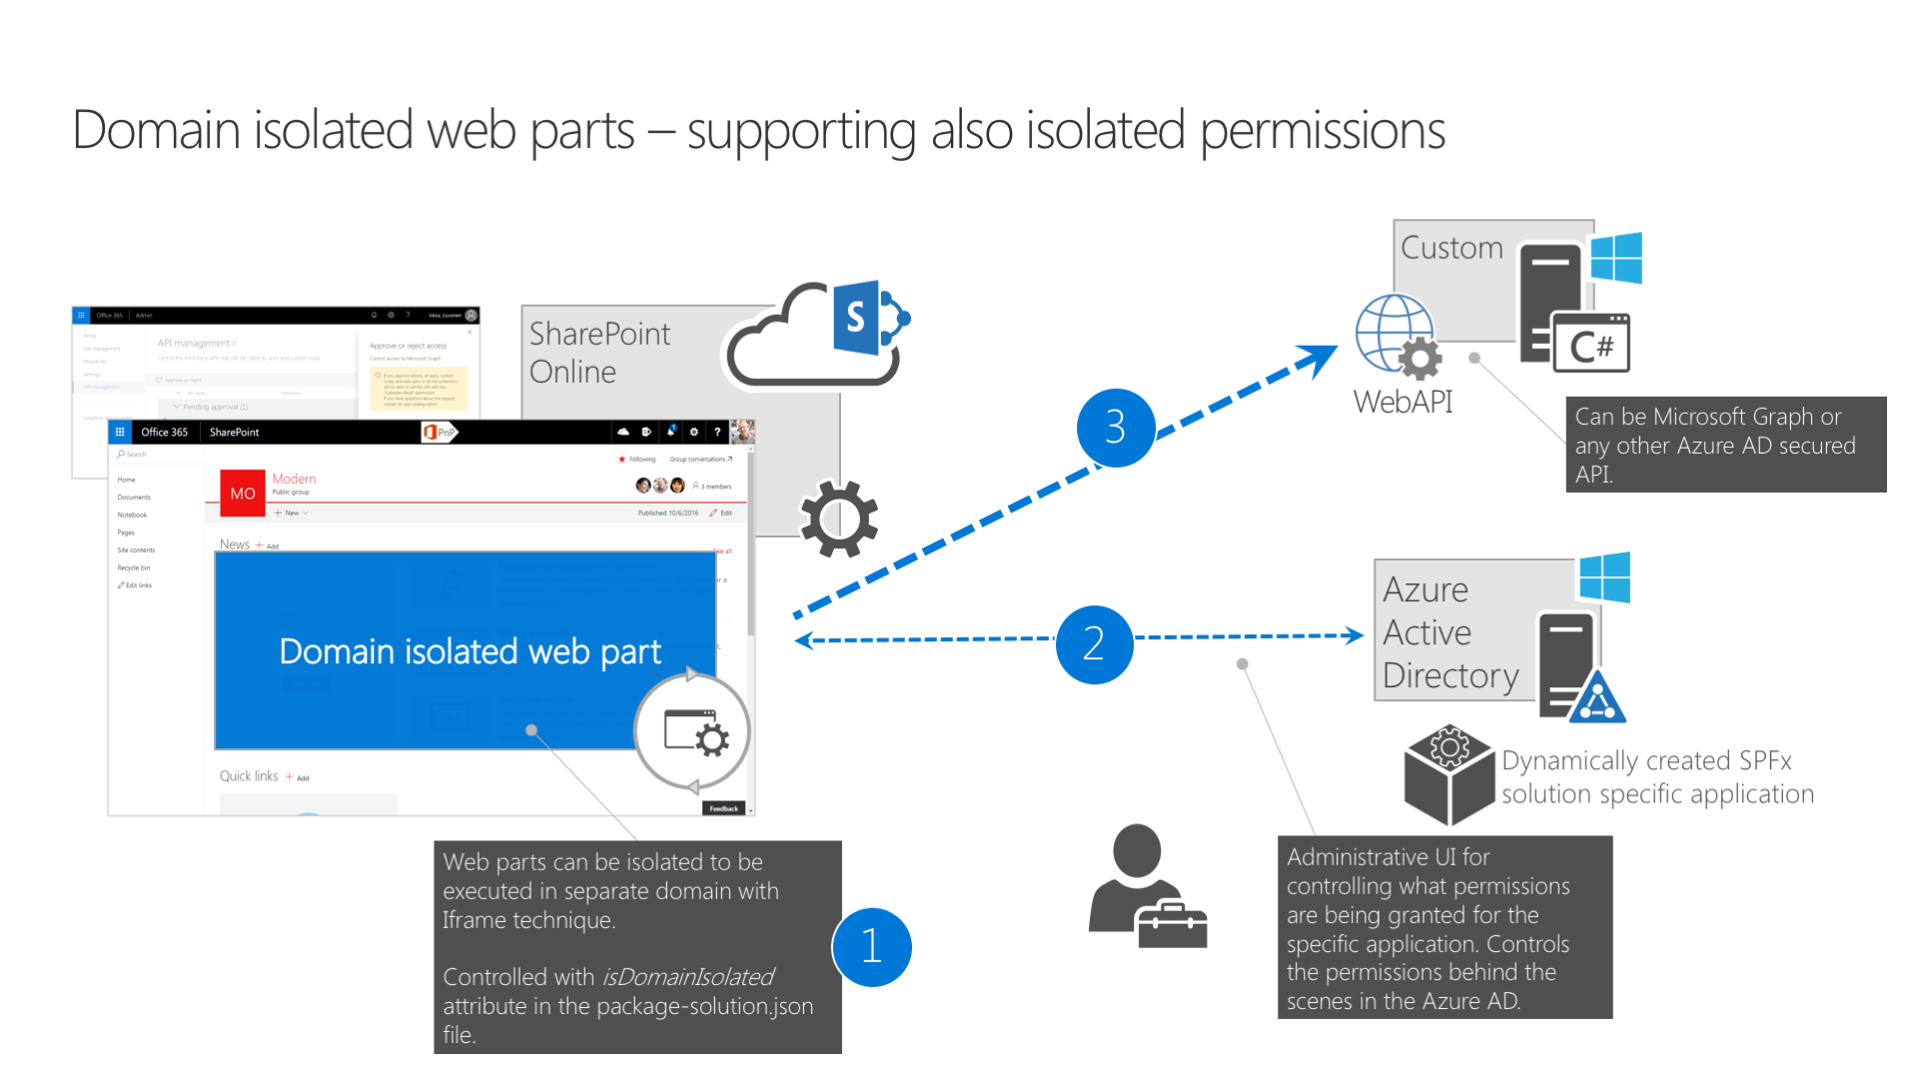
SPFX 1.8 Domain Isolated Web Parts

Slide 40
Resources
SPFx Documentation
SharePoint PnP
People I follow:
Andrew Connell
Sahil Malik
Github:
Code Samples
https://github.com/SharePoint/sp-dev-fx-webparts
SPFx + PnP Generator
https://pnp.github.io/generator-spfx/
YouTube
SharePoint Developer Community – PnP
Notes:
Julie is one of the leading experts on EF. If you have looked into EF at all, you probably know her name. Her pluralsight courses are great and her content is my go-to for any training or deep info. She’s also big on domain driven design.
The .NET Blog has EF specific tags.
Project Site on GitHub
PowerTools

Slide 41
Daniel Segan
dsegan@me.com |  @dsegan |  danielsegan

